Slide 1
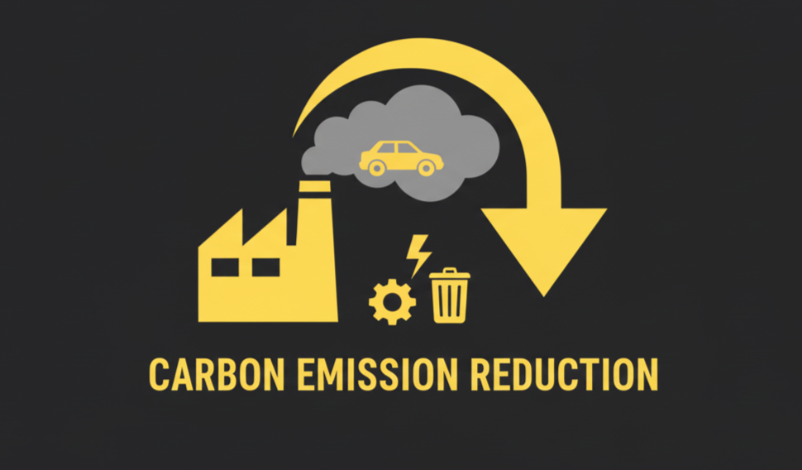
Core Objectives:
Track Emissions – Energy, transport, fuel, waste, logistics
Visualize Impact – Role-based dashboards, trends & comparisons
Set & Monitor Goals – SMART targets, progress bars, achievements
Provide Guidance – Tailored sustainability tips & best practices
Support Reporting – Data exports & compliance tools
Target Impact:
Carbon emission reduction
Stronger environmental awareness
Enable corporate sustainability reporting

Slide 2



Core Technologies
Frontend:
Backend:
React 18
Node.js + Express
MySQL
TypeScript
Tailwind CSS
Drizzle ORM
Recharts
JWT Authentication

Slide 3
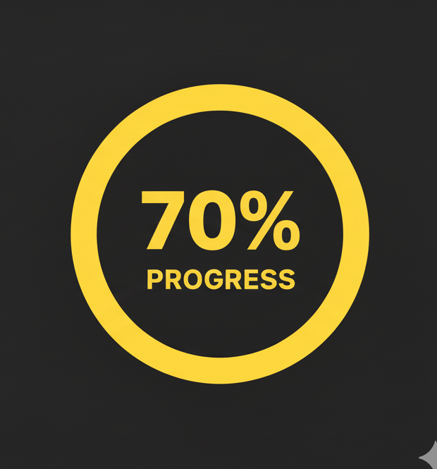



Project Progress
Fully Implemented
Authentication & user roles (Individual, Company, Admin)
Emission logging with categories & subcategories
Automatic CO₂ factor-based calculations
Dashboards with charts & responsive design
Goal setting & tracking with achievements
Sustainability tips (role & category-based)
Partially Implemented
Profile management (basic)
Data export (CSV ready, PDF in progress)
Planned Next Phase
Advanced analytics & benchmarking
Enhanced reporting & exports
Notifications & reminders
What-if scenario modeling

